Slide 1
Door unlocker interphone type
MeasurEments and actuators
Presented by Bejenariu Adina
Lupu Dima Daria
Pleșca Evelyn

Slide 2
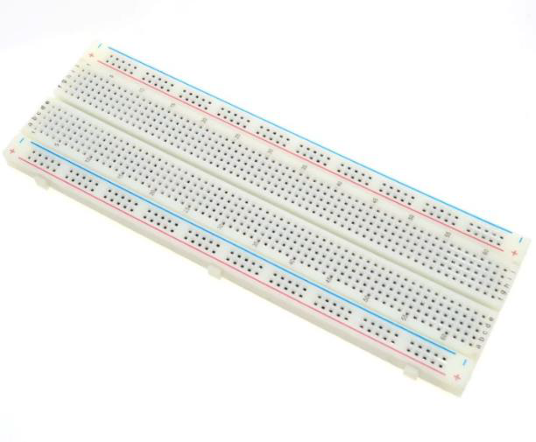
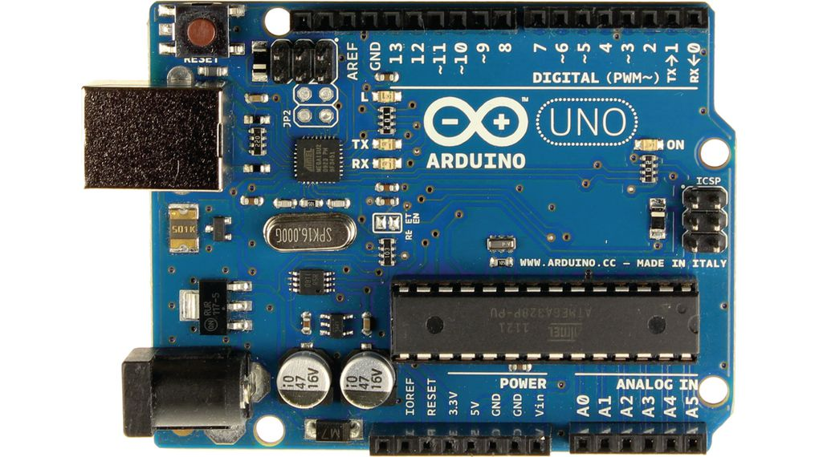
What we used
The main idea is the design of a mechanism that simulates the process of unlocking an intercom.
For the design mechanism the next components were used:
Breadboard to create the circuits
Motherboard Arduino UNO

Slide 3
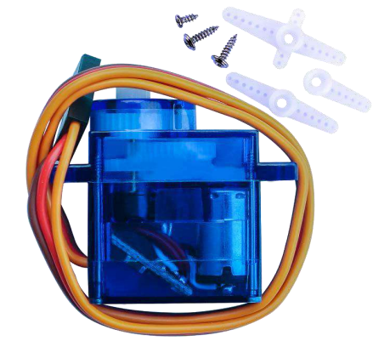
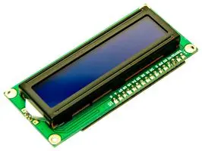
Servo motor SG90 used to simulate the door opening
LCD I2C with 4 pins and integrated potentiometer

Slide 4
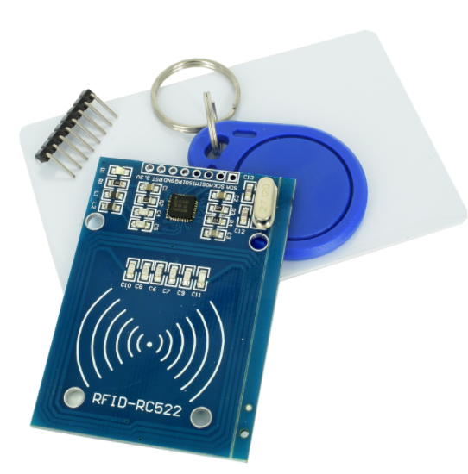
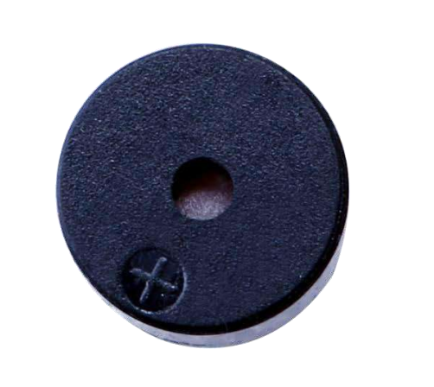
Rc522 RFID Module for personalized scanning
A passive buzzer used for sound

Slide 5
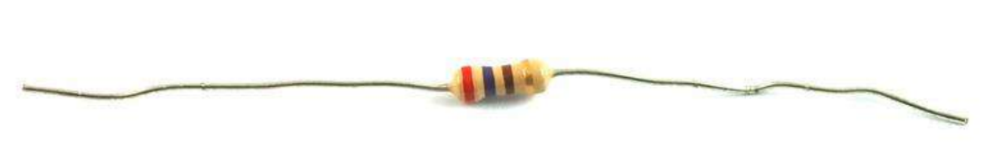
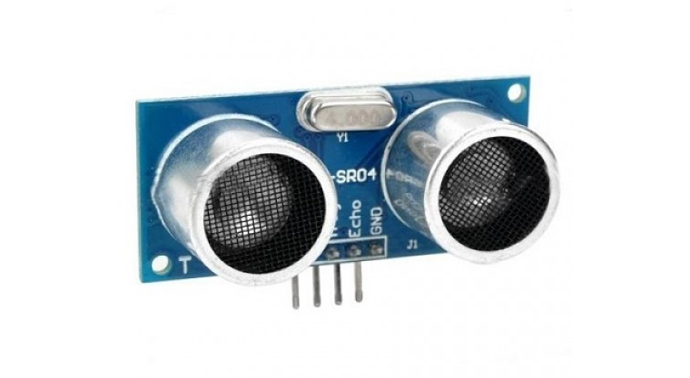
2 resistors of 220 ohm
Ultrasonic sensor HC-SR04

Slide 6
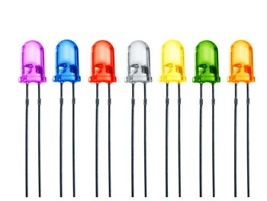
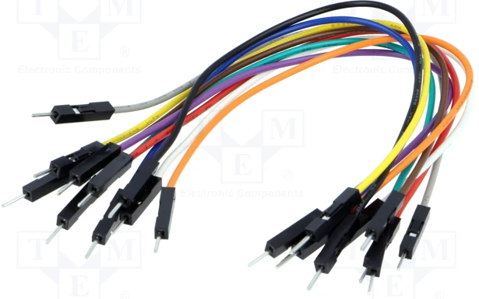
Used LED s
Male-to-male wires and female-to-male wires

Slide 7
HOW DOES IT WORK?
After the programme is activated the LCD display doesn’t show anything.
When the ultrasonic sensor senses an object close to it (distance 30cm or less) the LCD display shows the message: Buna ziua Prezentați cardu(l).
If the ultrasonic sensor senses an object close to it and the electromagnetic card is put next to the RFID module, the SG90 servo motor opens the door and the green LED turns on and the buzzer makes a specific sound.
If the ultrasonic sensor doesn’t sense an object close to it and the electromagnetic card is put next to the RFID module, the SG90 servo motor doesn’t open the door and the red LED stays on.

Slide 8
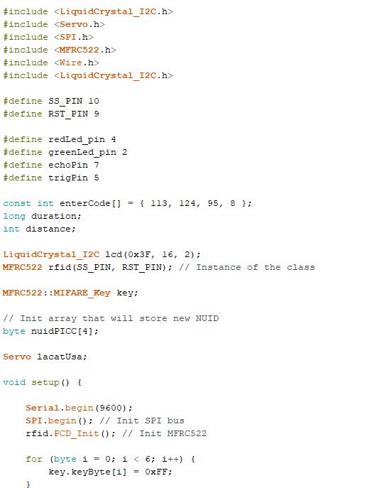
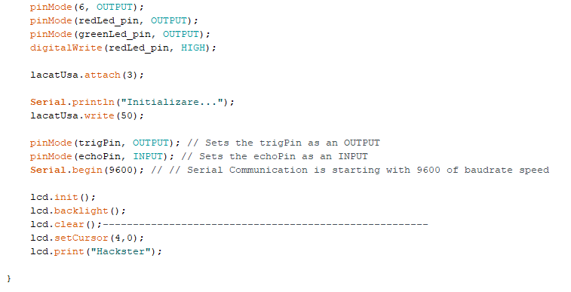

Slide 9
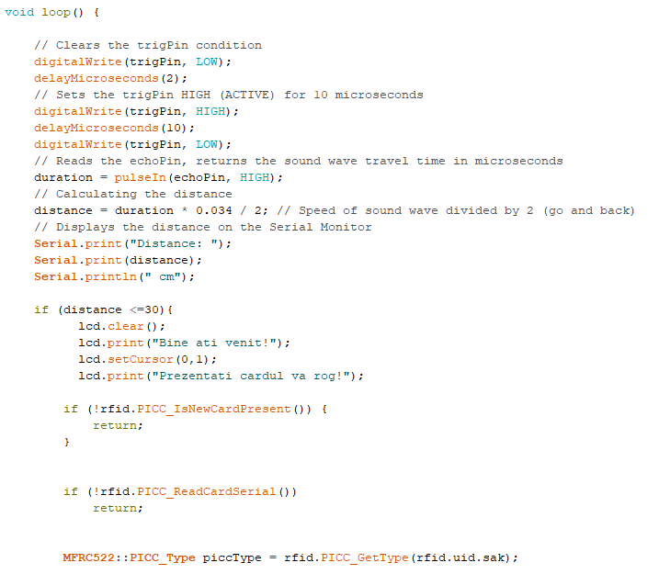
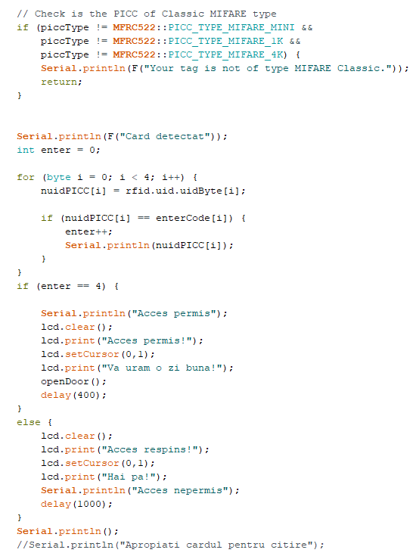

Slide 10
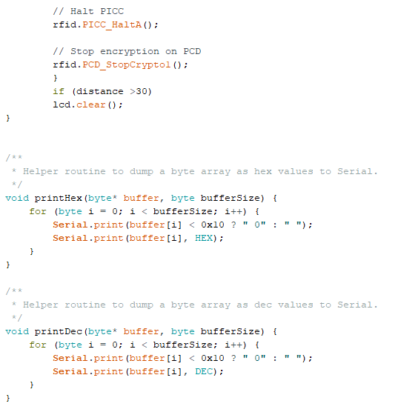
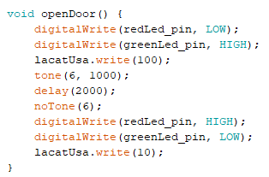

Slide 11
Components Explained
Description of the sensors and the actuators used

Slide 12
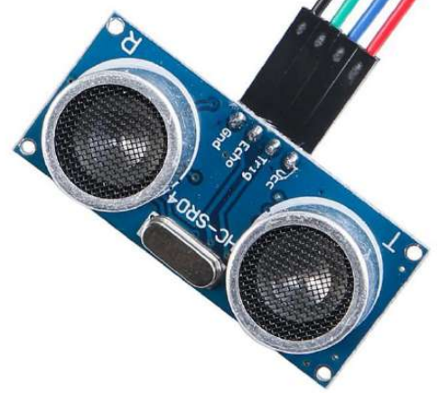
Ultrasonic Sensor
The main purpose of the ultrasonic (proximity) sensors is to detect the presence of objects without physical contact. An ultrasonic sensor emits an electromagnetic field or infrared rays, then it waits for changes in the electromagnetic field or it waits for a return signal.

Slide 13

Ultrasonic sensor module HC-SR04 provides 2cm-400cm non-contact measurement function, the ranging accuracy can reach to 3mm. The modules includes ultrasonic transmitters, receiver and control circuit. The basic principle of work:
1 - The Trigger Pin emits a signal
2 - The Echo pin waits for the signal to come back
3 - The sensor counts how much time it takes for the signal it emitted to go back, and based on that number it we use the following formula to find the distance
<- the wave travels back and forth

Slide 14
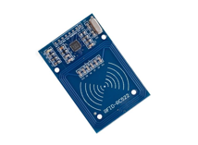
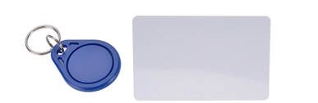
RFID Module
Radio-frequency identification (RFID) uses electromagnetic fields to automatically identify and track tags attached to objects. An RFID system consists of a tiny radio transponder, a radio receiver and transmitter. When triggered by an electromagnetic interrogation pulse from a nearby RFID reader device, the tag transmits digital data back to the reader.
In simple words an RFID uses electromagnetic fields to transfer data over short distances. RFID is useful to identify people, to make transactions, etc…
RFID module - MFRC522

Slide 15
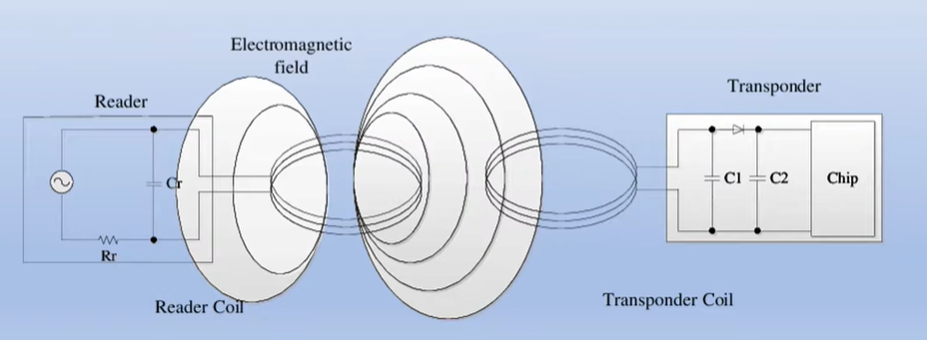
How a RFID module works

Slide 16
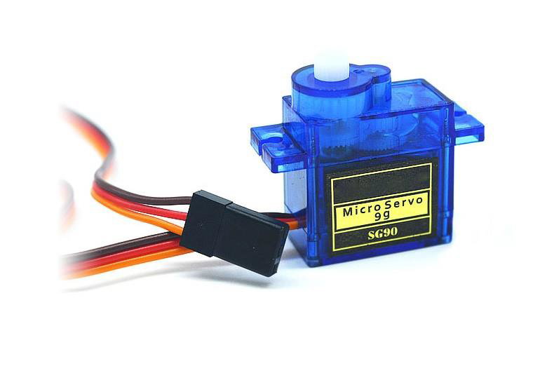
Servo motor SG90
Servo is a type of geared motor that can only rotate 180 degrees. It is controlled by
sending electrical pulses from your UNO board. These pulses tell the servo what
position it should move to. The Servo has three wires, of which the brown one is the
ground wire and should be connected to the GND port of UNO, the red one is the
power wire and should be connected to the 5v port, and the orange one is the signal
wire and should be connected to the Dig #9 port.
The servo motor SG90 used for the door unlocker

Slide 17
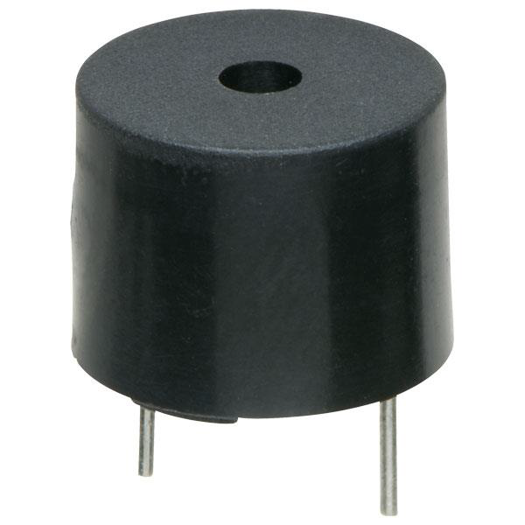
Passive Buzzer
The working principle of a passive buzzer is to use a PWM signal(Pulse Width Modulation) that generates sound to create vibrations in the air.
Modified according to the length of the vibration frequency, it can generate different sounds. For example, for a 523 Hz pulse, it can generate the Alto Do note, for a 587 Hz pulse, it can generate the Re note. With the help of the buzzer you can create a song.
A passive buzzer used for sound

Slide 18
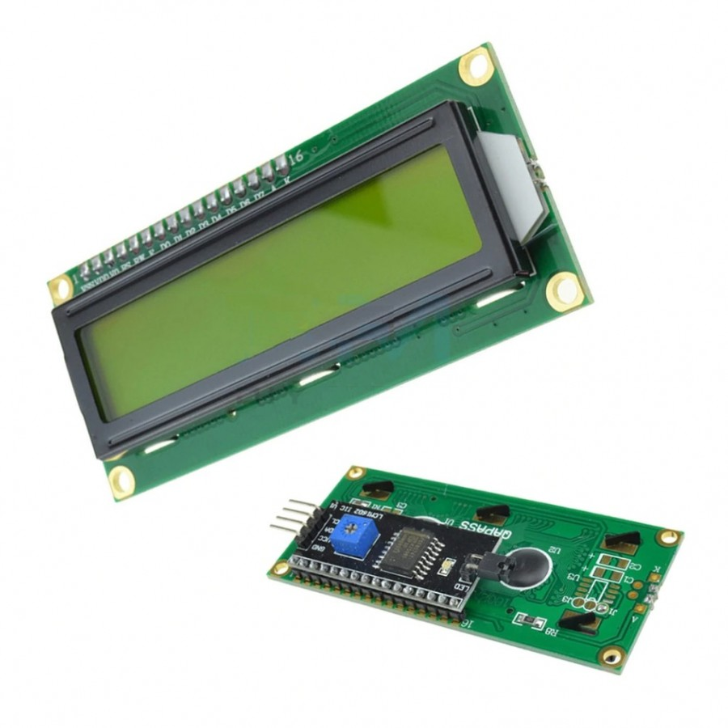
LCD I2C
The LCD IC2 is a LCD with the potentiometer already connected to the display. In consequence, it has only 4 pins to connect with the motherboard.
Liquid Crystal Display I2C

Slide 19
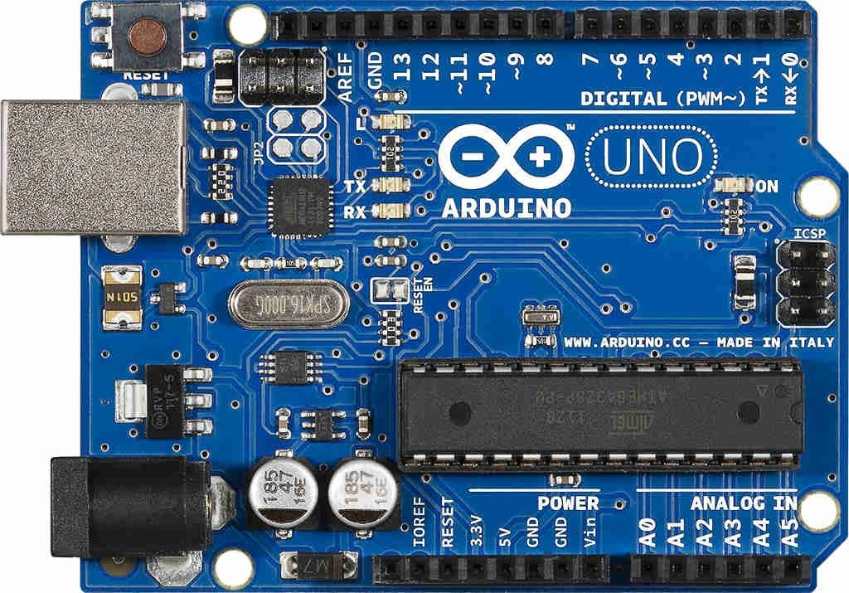
Arduino UNO

Slide 20
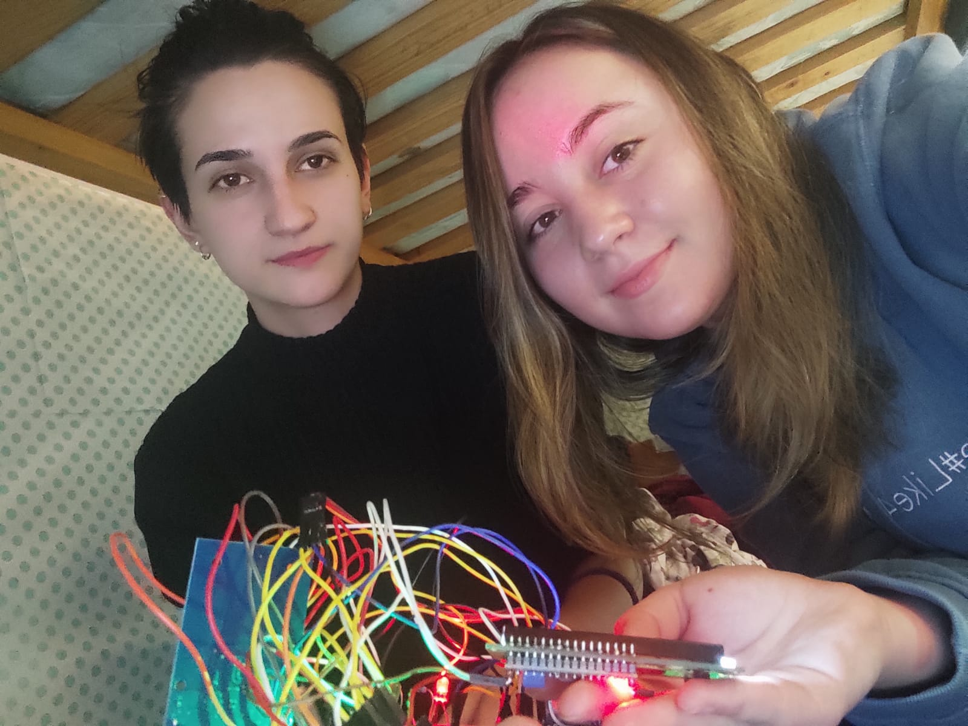
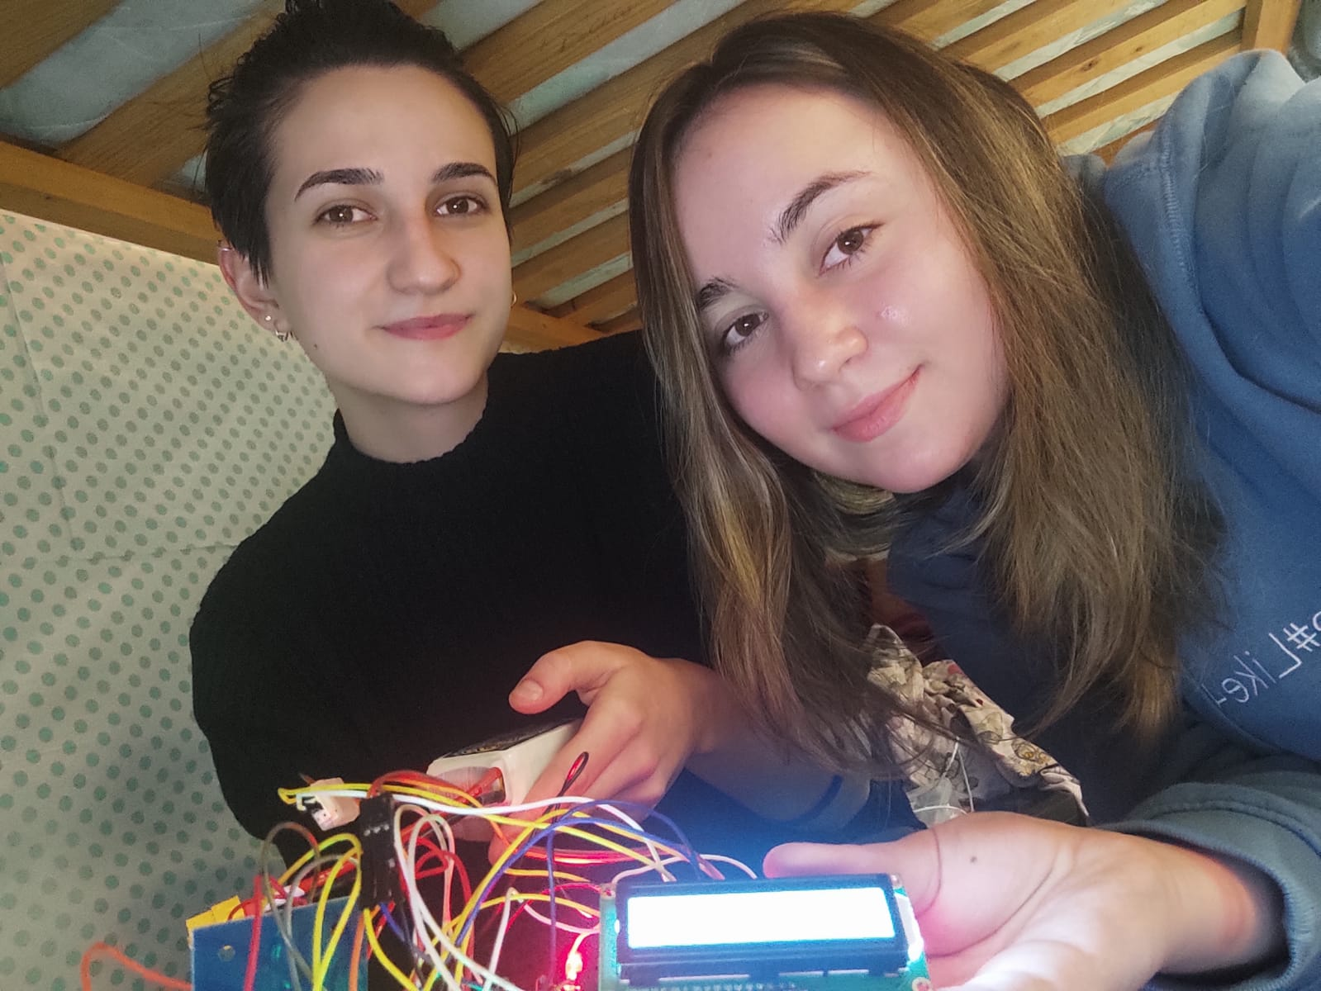
The process of making:

Slide 21
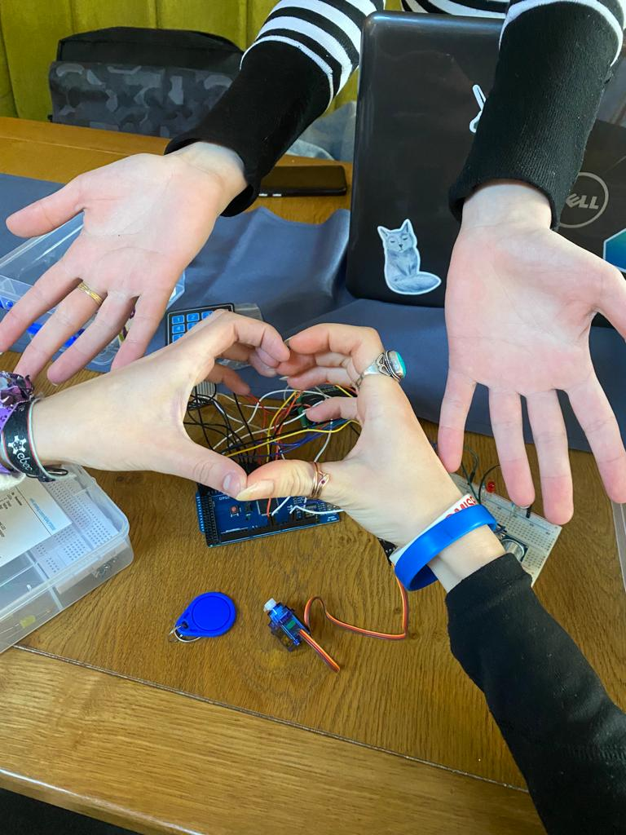
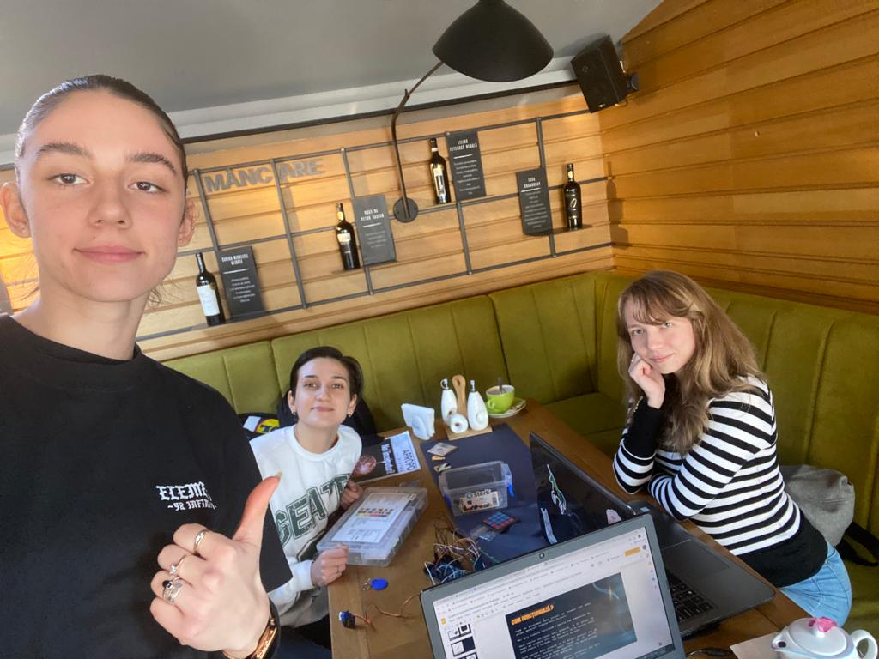

Slide 22
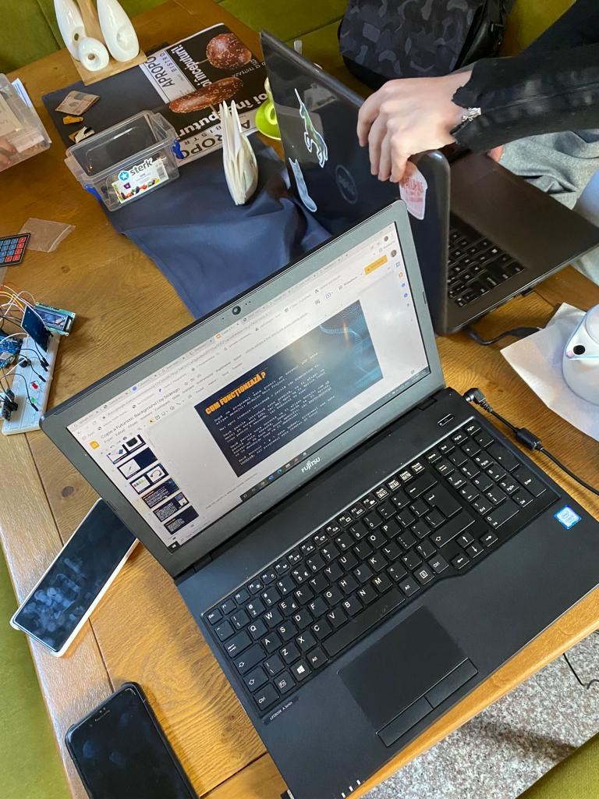
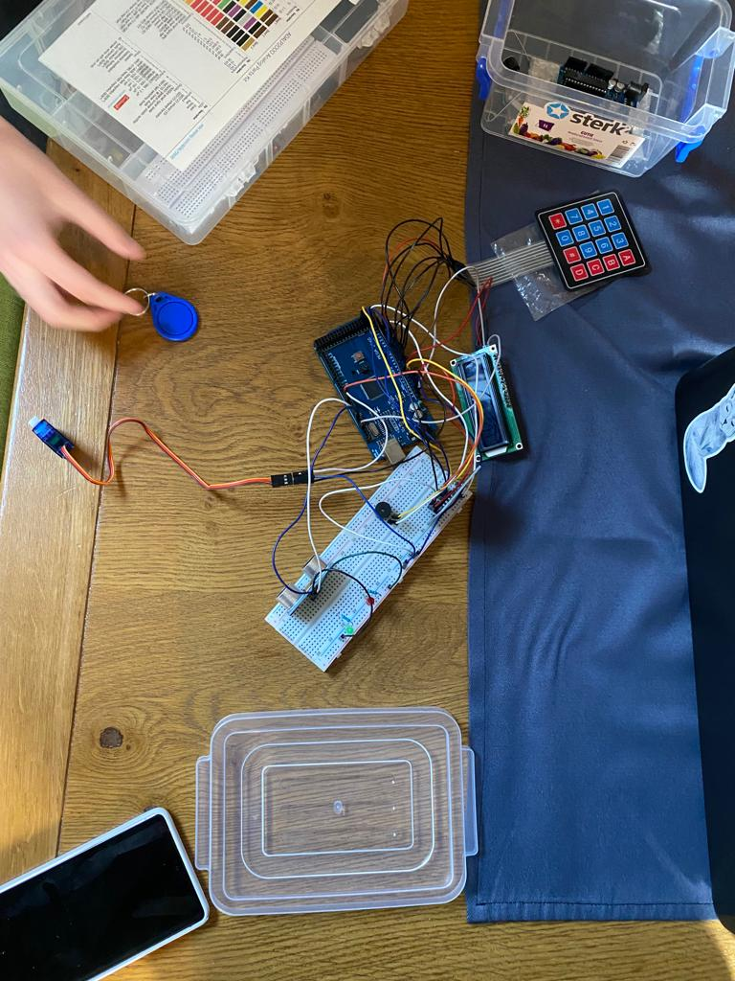

Slide 23
A video demonstration here :
https://drive.google.com/file/d/1cHPONS5QSmSHxG1cl3XyhdReoxNWwDpS/view?usp=sharing
Our code can be found here:
https://github.com/plescaevelyn/door-unlocker-interphone

Slide 24
BIBLIOGRAFIE
18%
34%
https://images-na.ssl-images-amazon.com/images/I/D1oC-c3G5TS.pdf
https://www.youtube.com/watch?v=FwbWvjq_iiM
Mercury is the smallest planet
Mars is a cold place

